Slide 1
Final Project Proposal
DC Lab Spring 2025
team 09 / 丁睿濂、林靖軒、劉代恩

Slide 2
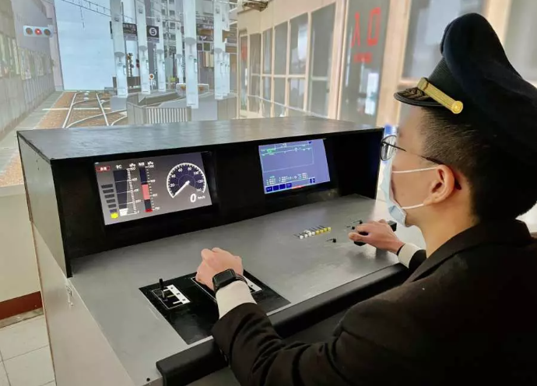
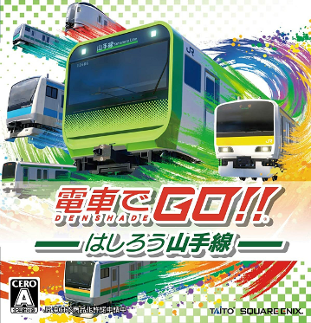
TRAIN SIMULATOR
帥哥

Slide 3
BASIC functions
Input:
Joystick (acceleration, brake, ...) → FPGA
Computer (video frames & speed labels) → FPGA
Function:
Receive control from joystick and calculate speed correspondingly
Adjust output rate to display video according to user control
Output:
FPGA → LCD, 7-seg display (show speed and pressure guage)
FPGA → Monitor (show video)

Slide 4
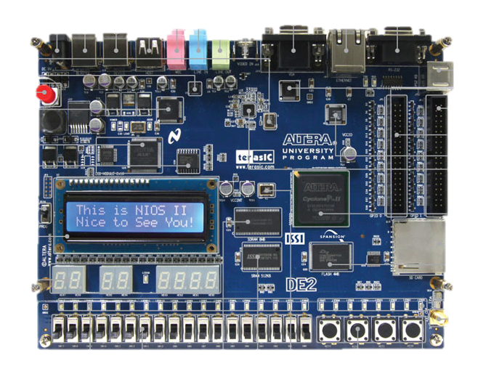
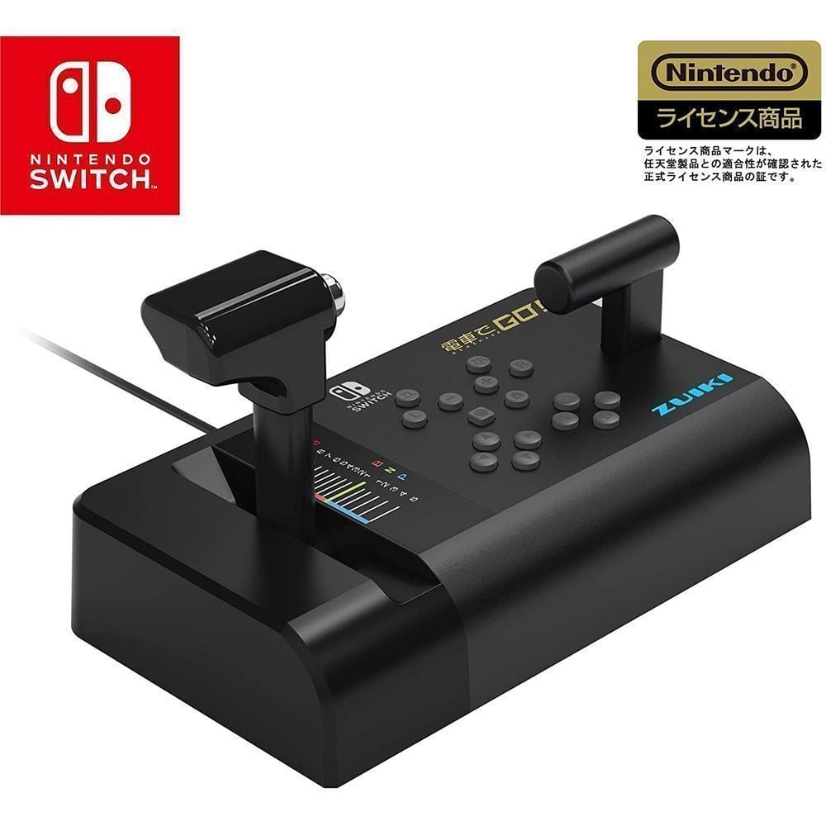
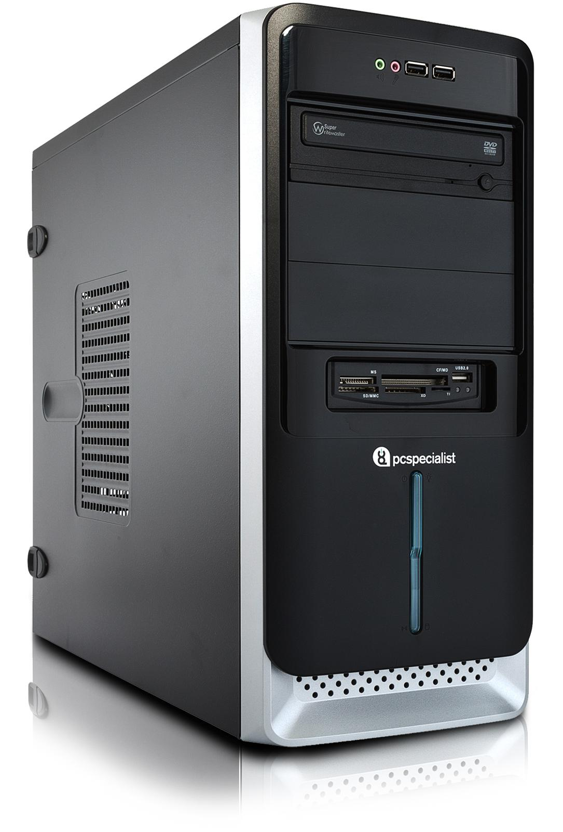
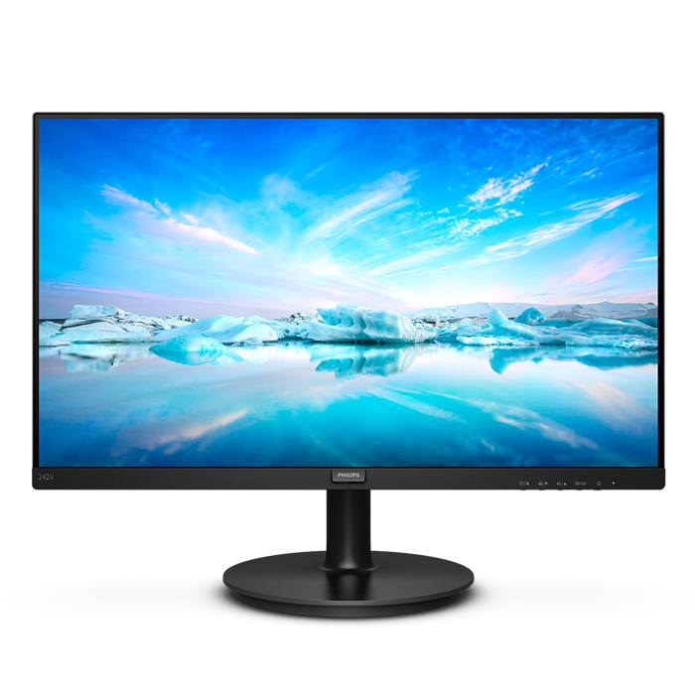
Hardware
joystick
PC
DE2-115
Monitor

Slide 5
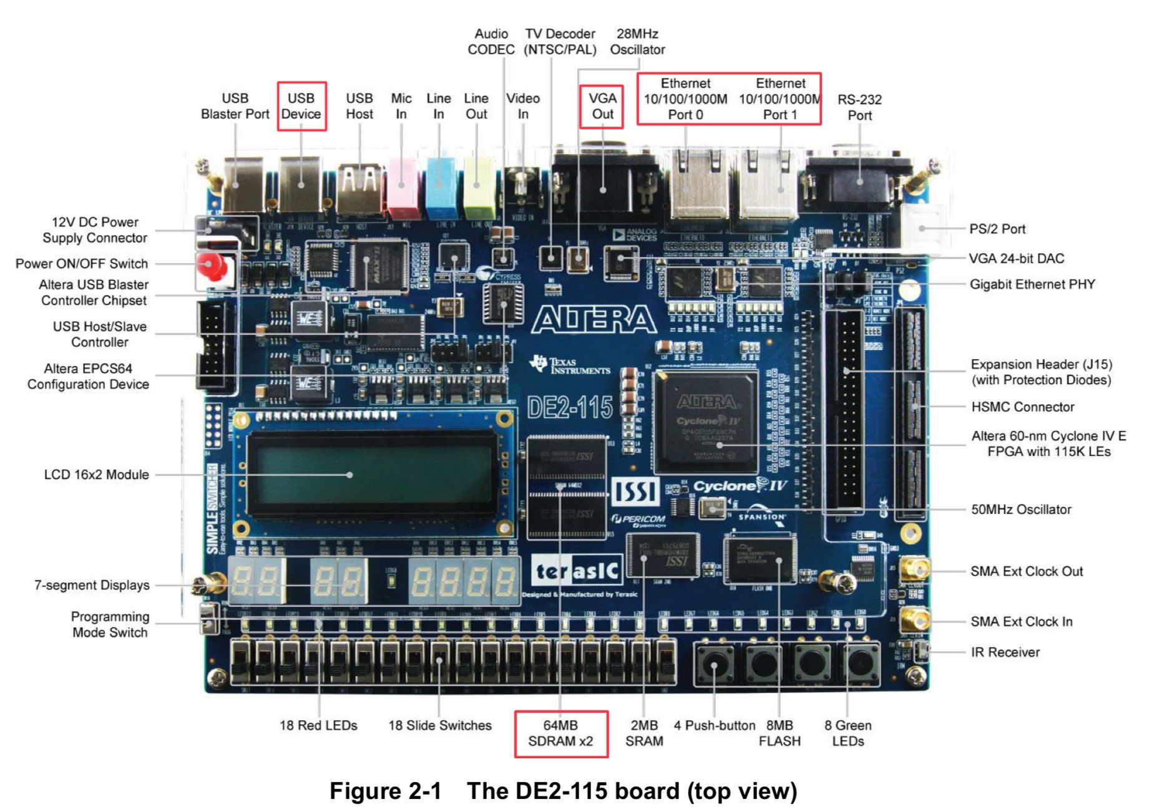
CONNECTIONS

Slide 6
Connections
USB (joystick → FPGA): control playback speed by acceleration and brake
Design the joystick on our own
Ethernet (PC → FPGA): send video data and speed labels
Cat 5e cable is required, which supports transmission rate up to 1,000 Mbps
The single Ethernet port on our PC is already occupied → USB to Ethernet adapter is required, which also supports 1,000 Mbps transmission rate
Run Python program in PC to send and receive UDP packets to/from the FPGA
Capable for real-time applications
VGA (FPGA → Monitor): output corresponding video
SXGA standard (1280*1024)
Bandwidth 100MHz

Slide 7
Block diagram
SDRAM
Joystick
Joystick Control
SDRAM Control
VGA Control
Monitor
UDP parser
Top
7-Seg display
PC
Ethernet Connection
LCD

Slide 8
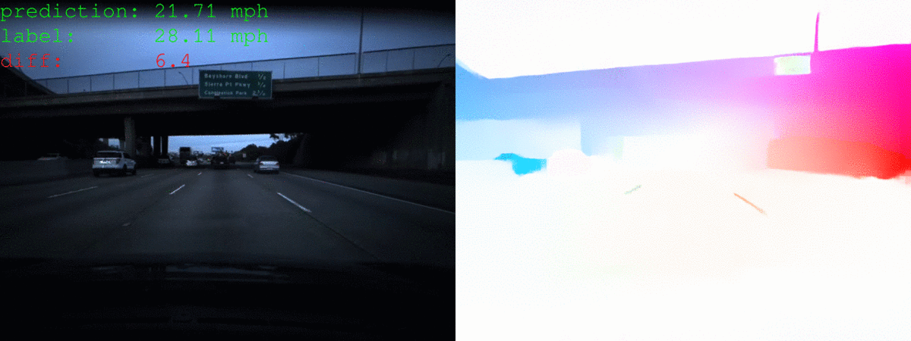
If allowed
Train a ML model to predict speed label of the video (Ref: GitHub)
Run the ML inference on FPGA board
Record arrival time and other performances to get scored
Random weather effects, special events
Add sound for the motor sound, brake sound, and whistling sound

Slide 9
WHY USE FPGA?
Flexibility
Download any video and start playing after few processing
Deal with complex protocols between FPGA and joystick
Parallel processing
FPGAs are ideal for processing the input from joystick and PC and output to monitor
Low latency & real-time data handling
FPGA provides faster response times, which is a fit for real-time data processing

Slide 10
Potential issues & possible solutions
Unknown protocol between Switch and joystick
Use logic analyzer to find the protocol of joystick → it takes a long time to decode the “private protocol” designed by Nintendo Switch
Design our own joystick and communication protocol as a current solution
SDRAM or Ethernet does not work
Read user manual or look up for other's experience

Slide 11
Reference
DE2-115 User Manual
https://www.terasic.com.tw/wiki/images/f/f2/DE2_115_manual.pdf
Ethernet
https://medium.com/@Frank_pan/how-to-use-ethernet-components-in-fpga-altera-de2-115-26659da06362
https://github.com/alexforencich/verilog-ethernet
SDRAM
邏輯電路設計DE2-115實戰寶典
Vehicle Speed Estimation
shafu0x/vehicle-speed-estimation: Vehicle Speed Estimation from Video using Deep Learning and Optical Flow in PyTorch.

